Slide 1

ECE 2700
Digital Circuits
Register-Transfer Level (RTL) Design
Copyright © 2010 Frank Vahid
Instructors of courses requiring Vahid's Digital Design textbook (published by John Wiley and Sons) have permission to modify and use these slides for customary course-related activities, subject to keeping this copyright notice in place and unmodified. These slides may be posted as unanimated pdf versions on publicly-accessible course websites.. PowerPoint source (or pdf with animations) may not be posted to publicly-accessible websites, but may be posted for students on internal protected sites or distributed directly to students by other electronic means. Instructors may make printouts of the slides available to students for a reasonable photocopying charge, without incurring royalties. Any other use requires explicit permission. Instructors may obtain PowerPoint source or obtain special use permissions from Wiley – see http://www.ddvahid.com for information.

Slide 2
Today’s Objectives
To become familiar with RTL design
To know how to create a high-level state machine and corresponding controller

Slide 3
What is RTL?
Register-transfer level design
  Used to build processors
    Custom in our case
  Makes use of datapath components
    State machines with data operations
Register-
Higher levels
t
r
ans
f
er
l
e
v
el (
R
TL)
Logic l
e
v
el
T
r
ansistor l
e
v
el
Levels of digital design abstraction

Slide 4
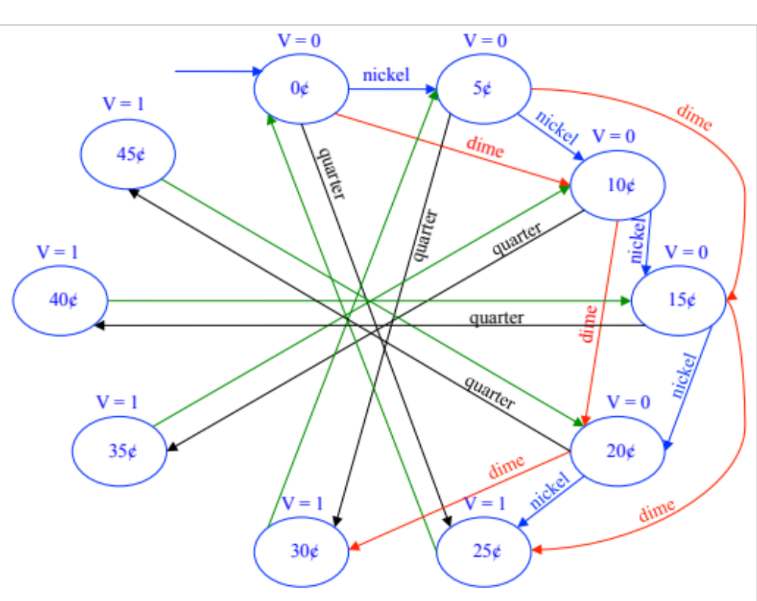

Vending Machine Revisited
Inputs: nickel, dime, quarter
Output: V
What if the machine accepts a penny?

Slide 5
High-Level State Machine (HLSM)
Some behaviors too complex for FSMs
  HLSM can help in such a case
Let’s rethink our vending
machine
  c: bit input, 1 when coin deposited
  a: 8-bit input having value of
  deposited coin
  s: 8-bit input having cost of a
  soda
  d: bit output, processor sets to 1
  when total value of deposited coins equals or exceeds cost of a soda
s
a
c
Soda
d
dispenser
processor
s
a
25
50
25
0
1
0
1
0
c
tot:
50
Soda
tot:
25
d
dispenser
0
1
0
processor

Slide 6
State Machines
FSM
HLSM
Single bit inputs and outputs
Boolean operations
Multiple bit inputs and outputs
Arithmetic operations
Local storage

Slide 7
Vending Machine HLSM
s
a
Features
  Multi-bit input/output
  Local storage
  Arithmetic operations
8
8
c
Soda
d
dispenser
processor
Inputs:
c
(bit),
a (8 bits), s (8 bits)
Outputs:
d (bit) // '1' dispenses soda
Local stor
a
g
e
:
tot (8 bits)
c
tot:=tot+a
Add
Init
W
ait
d:='0'
c'
∗
(
tot<s
)
tot:=0
c’*(tot<s)’
Disp
SodaDispenser
d:='1'

Slide 8
HLSM Conventions
s
a
Numbers
  Single-bit: '0' (single quotes)
  Integer: 0 (no quotes)
  Multi-bit: “0000” (double quotes)
== for equal, := for assignment
Multi-bit outputs
must be registered
via local storage
8
8
c
Soda
d
dispenser
processor
Inputs:
c
(bit),
a (8 bits), s (8 bits)
Outputs:
d (bit) // '1' dispenses soda
Local stor
a
g
e
:
tot (8 bits)
c
tot:=tot+a
Add
Init
W
ait
d:='0'
c'
∗
(
tot<s
)
tot:=0
c'*(tot<s)’
Disp
SodaDispenser
d:='1'

Slide 9
Example: Event Counter
B: 1-bit input
C: 16-bit output (unsigned), initially 0
Want an HLSM that counts the number of events occurred so far
  Event: B switches from 0 to 1, or B switches from 1 to 0
Count (C) rolls over when
maximum value is
reached
Inputs:
c
(bit),
a (8 bits), s (8 bits)
Outputs:
d (bit) // '1' dispenses soda
Local stor
a
g
e
:
tot (8 bits)
c
tot:=tot+a
Add
Init
W
ait
d:='0'
c'
∗
(
tot<s
)
tot:=0
c’*(tot<s)’
Disp
SodaDispenser
d:='1'

Slide 10
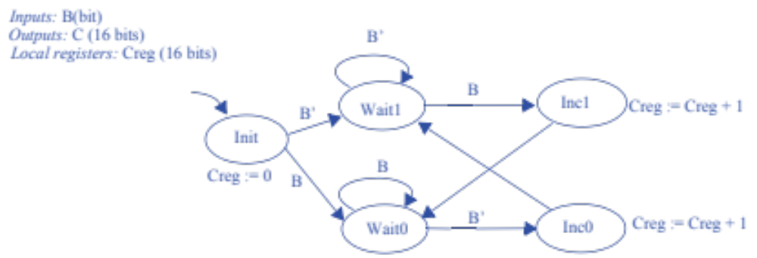
Example: Event Counter
B
B’
B
B’

Slide 11
HLSM Actions
Local storage updated on clock edges only
  Storage writes in that state occur on next clock edge
  Can think of as occurring on outgoing transitions
  Thus, transition conditions use the OLD value, not the newly-written value
S'
S3
S
Dctr := Dctr+1
S' /
Dctr := Dctr+1
S3
S /
Dctr := Dctr+1

Slide 12
Question
What’s the final state?
Q < 100
C
A
B
(Q < 100)'
R := 99
R := R+1
Q := R
D
Q := 0

Slide 13
RTL Design Process
Capture behavior
Convert to circuit
Architecture
  Datapath capable of HLSM's data operations
  Controller to control datapath
External data
inputs
DP
...
External
control
control
inputs
inputs
...
...
Controller
Datapath
External
...
control
...
outputs
DP
control
...
outputs
External data
outputs

Slide 14
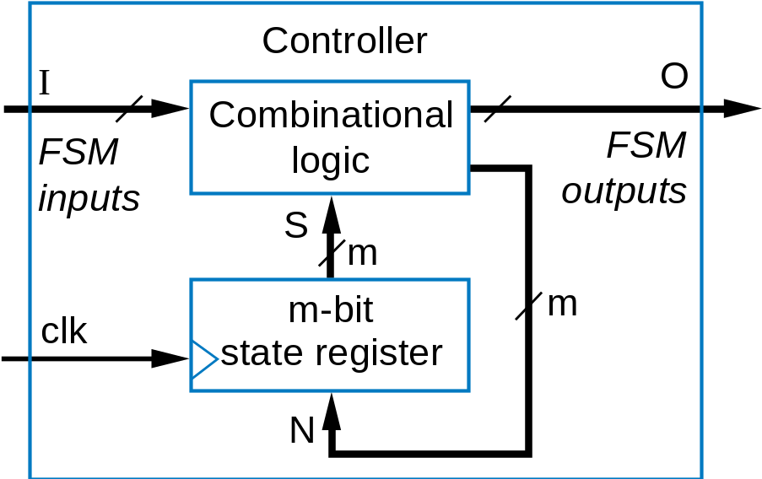
Design
FSM
HLSM
External data
inputs
DP
...
External
control
control
inputs
inputs
...
...
Controller
Datapath
External
...
control
...
outputs
DP
control
...
outputs
External data
outputs

Slide 15
Datapath Component Library
clr
I
A
B
A
B
I
I
1
I
0
ld
reg
add
cmp
shift<L/R>
mux2x1
Q
S
lt
eq
gt
Q
s0
Q
clk^ and clr=1: Q=0
S = A+B
(unsigned)
shiftL1: <<1
s0=0: Q=
I
0
clk^ and ld=1: Q=
I
A<B: lt=1
shiftL2: <<2
s0=1: Q=
I
1
else Q stays same
A=B: eq=1
shiftR1: >>1
A>B: gt=1
...

Slide 16
Examples for Datapath Creation
X
Y
Z
X
X
Y
Z
X
Y
Z
Preg = X + Y + Z
Preg = Preg + X
Preg=X+Y; regQ=Y+Z
k
k=0: Preg = Y + Z
k=1: Preg = X + Y
Preg
Preg
Preg
regQ
Preg
P
P
P
Q
P
X
Y
Z
X
X
Y
Z
X
Y
Z
DP
DP
A
B
add1
A
B
A
B
A
B
S
add1
A
B
A
B
add1
add2
S
add1
add2
S
S
X + Y
S
S
A
B
0
clr
I
I
1
I
0
add2
1
ld
Preg
0
clr
I
0
clr
I
mux2x1
S
Q
1
ld
Preg
1
ld
regQ
k
s0
Q
X + Y + Z
Q
Q
0
clr
I
P
P
Q
0
clr
I
1
ld
Preg
1
ld
Preg
DP
Q
DP
Q
P
P

Slide 17

Back To The Vending Machine
s
a
Steps
Create datapath
Connect datapath to controller
Derive controller FSM
Tips
  HLSM data I/O → DP I/O
  HLSM local storage → reg
  HLSM state action and
  transition: condition, data
  computation → DP
  components and connections
tot_ld
ld
tot
tot_clr
clr
8
8
8
tot_lt_s
8-bit
8-bit
<
adder
8
Inputs
:
c
(bit),
a (8 bits), s (8 bits)
Datapath
Outputs
:
d (bit) // '1' dispenses soda
Local stor
a
g
e
:
tot (8 bits)
c
Add
Init
W
ait
tot:=tot+a
d:='0'
c'
∗
(
tot<s
)
tot:=0
c’*(tot<s)’
Disp
SodaDispenser
d:='1'

Slide 18
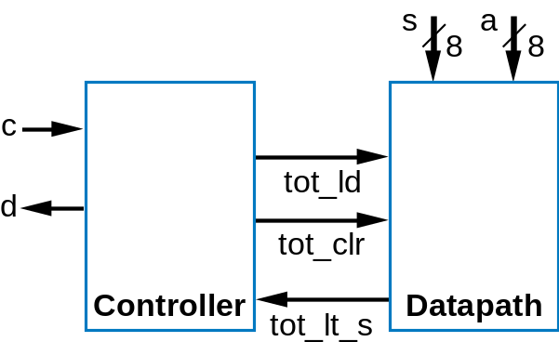
Back To The Vending Machine
s
a
Steps
Create datapath
Connect datapath to controller
Derive controller FSM
tot_ld
ld
tot
tot_clr
clr
8
8
8
tot_lt_s
8-bit
8-bit
<
adder
Inputs
:
c
(bit),
a (8 bits), s (8 bits)
Datapath
8
Outputs
:
d (bit) // '1' dispenses soda
Local stor
a
g
e
:
tot (8 bits)
c
Add
Init
W
ait
tot:=tot+a
d:='0'
c'
∗
(
tot<s
)
tot:=0
c’*(tot<s)’
Disp
SodaDispenser
d:='1'

Slide 19
Back To The Vending Machine
Steps
Create datapath
Connect datapath to controller
Derive controller FSM
Inputs
:
c,
tot_lt_s
(bit)
Inputs
:
c
(bit),
a (8 bits), s (8 bits)
Outputs
:
d,
tot_ld
,
tot_clr
(bit)
tot_ld
Outputs
:
d (bit) // '1' dispenses soda
c
c
Local stor
a
g
e
:
tot (8 bits)
d
Add
tot_clr
Init
Wait
c
tot_ld=1
tot_lt_s
Add
d=0
∗
c
′
∗
tot_lt_s
Init
W
ait
tot_clr=1
c'
tot_lt_s’
tot:=tot+a
Disp
d:='0'
c'
∗
(
tot<s
)
Controller
d=1
tot:=0
c’*(tot<s)’
This is simply an FSM
Disp
Same states and transitions
SodaDispenser
d:='1'

Slide 20
Example
For the event counter HLSM designed earlier
  Create a datapath
  Connect the datapath to a controller
  Derive the controller’s FSM
B
B’
B
B’

Slide 21
Example
For the event counter HLSM designed earlier
  Create a datapath
  Connect the datapath to a controller
  Derive the controller’s FSM
s
a
Inputs
:
c,
tot_lt_s
(bit)
tot_ld
ld
tot
Outputs
:
d,
tot_ld
,
tot_clr
(bit)
tot_ld
tot_clr
clr
c
c
8
d
Add
tot_clr
8
8
Init
Wait
tot_ld=1
tot_lt_s
d=0
∗
c
′
∗
tot_lt_s
tot_lt_s
8-bit
8-bit
tot_clr=1
c'
tot_lt_s’
<
adder
Disp
Datapath
8
Controller
d=1

Slide 22
Today’s Objectives
To become familiar with RTL design
To know how to create an HLSM and corresponding controller

